Slide 1


Computer Architecture Spring 2020
Hamed Farbeh
farbeh@aut.ac.ir
Department of Computer Engineering
Amirkabir University of Technology

Slide 2
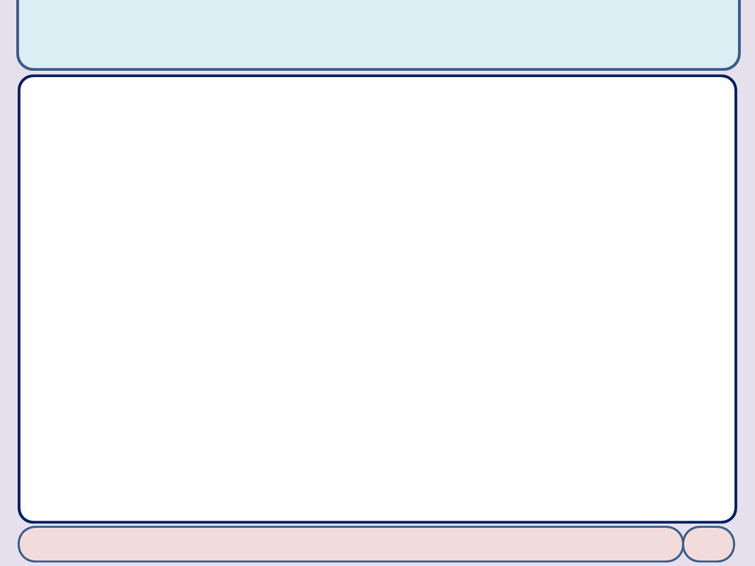

Copyright Notice
Lectures adopted from
Computer Organization and Design: The Hardware/Software Interface, 5th edition, David A. Patterson, John L. Hennessy, MK pub., 2014
Chapter 3: Arithmetic for Computers
Computer Architecture, Spring 2020, AUT, Tehran, Iran

Slide 3
Chapter 3
Arithmetic for Computers

Slide 4
Floating-Point Addition
Consider a 4-digit decimal example
9.999 × 10¹ + 1.610 × 10^{–1}
1. Align decimal points
Shift number with smaller exponent
9.999 × 10¹ + 0.016 × 10¹
2. Add significands
9.999 × 10¹ + 0.016 × 10¹ = 10.015 × 10¹
3. Normalize result & check for over/underflow
1.0015 × 10²
4. Round and renormalize if necessary
1.002 × 10²

Slide 5
Floating-Point Addition
Now consider a 4-digit binary example
1.000₂ × 2^{–1} + –1.110₂ × 2^{–2} (0.5 + –0.4375)
1. Align binary points
Shift number with smaller exponent
1.000₂ × 2^{–1} + –0.111₂ × 2^{–1}
2. Add significands
1.000₂ × 2^{–1} + –0.111₂ × 2–1 = 0.001₂ × 2^{–1}
3. Normalize result & check for over/underflow
1.000₂ × 2^{–4}, with no over/underflow
4. Round and renormalize if necessary
1.000₂ × 2^{–4} (no change) = 0.0625

Slide 6
FP Adder Hardware
Much more complex than integer adder
Doing it in one clock cycle would take too long
Much longer than integer operations
Slower clock would penalize all instructions
FP adder usually takes several cycles
Can be pipelined

Slide 7
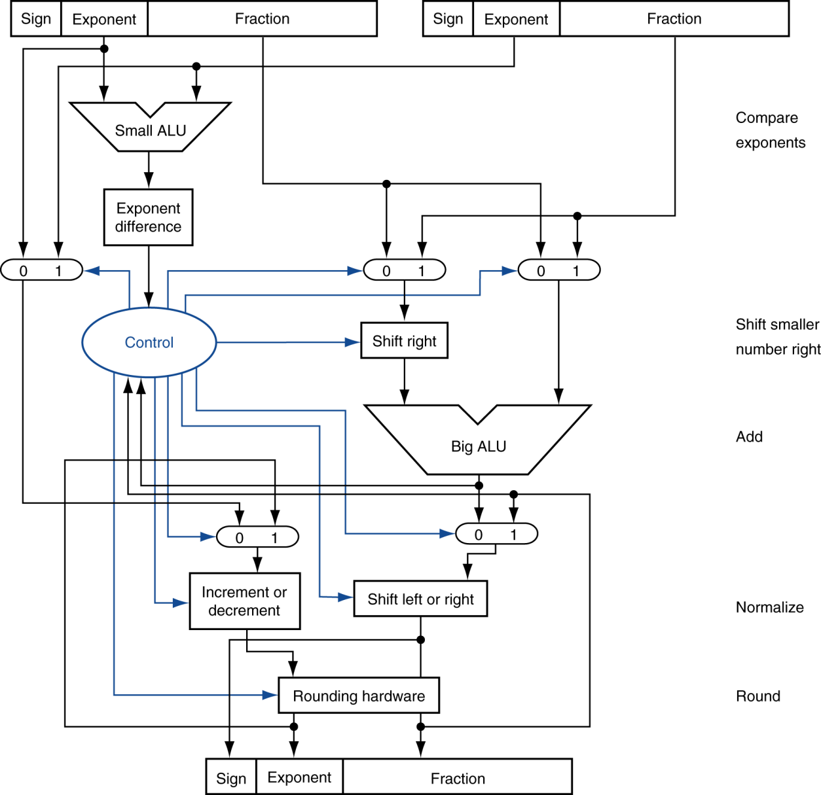
FP Adder Hardware
Step 1
Step 2
Step 3
Step 4

Slide 8
Floating-Point Multiplication
Consider a 4-digit decimal example
1.110 × 10¹⁰ × 9.200 × 10^{–5}
1. Add exponents
For biased exponents, subtract bias from sum
New exponent = 10 + –5 = 5
2. Multiply significands
1.110 × 9.200 = 10.212 ⇒ 10.212 × 10⁵
3. Normalize result & check for over/underflow
1.0212 × 10⁶
4. Round and renormalize if necessary
1.021 × 10⁶
5. Determine sign of result from signs of operands
+1.021 × 10⁶

Slide 9
Floating-Point Multiplication
Now consider a 4-digit binary example
1.000₂ × 2^{–1} × –1.110₂ × 2^{–2} (0.5 × –0.4375)
1. Add exponents
Unbiased: –1 + –2 = –3
Biased: (–1 + 127) + (–2 + 127) = –3 + 254 – 127 = –3 + 127
2. Multiply significands
1.000₂ × 1.110₂ = 1.1102 ⇒ 1.110₂ × 2^{–3}
3. Normalize result & check for over/underflow
1.110₂ × 2^{–3} (no change) with no over/underflow
4. Round and renormalize if necessary
1.110₂ × 2^{–3} (no change)
5. Determine sign: +ve × –ve ⇒ –ve
–1.110₂ × 2^{–3} = –0.21875

Slide 10
FP Arithmetic Hardware
FP multiplier is of similar complexity to FP adder
But uses a multiplier for significands instead of an adder
FP arithmetic hardware usually does
Addition, subtraction, multiplication, division, reciprocal, square-root
FP ↔ integer conversion
Operations usually takes several cycles
Can be pipelined

